Slide 1
Recovering a Causal Effect from AA Baseball Banning the Shift on Batter Outcomes

Slide 2
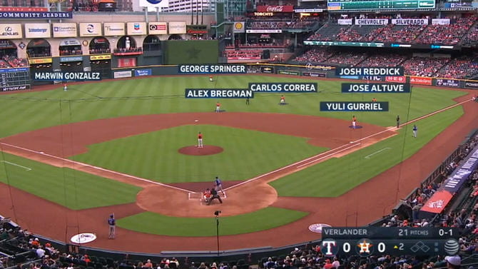
Background
What is the shift?
Why do teams use the shift?
Joey Gallo at bat against the Houston Astros.
Notes:
The MLB defines the shift as, “a term used to describe the situational defensive realignment of fielders away from their "traditional" starting points.” What this means in practice is usually moving three or more infielders to the same side of second base, as you can see in this example, where the Astros are shifting against Joey Gallo. The goal of the shift is to put the defense in the best position to record an out.

Slide 3
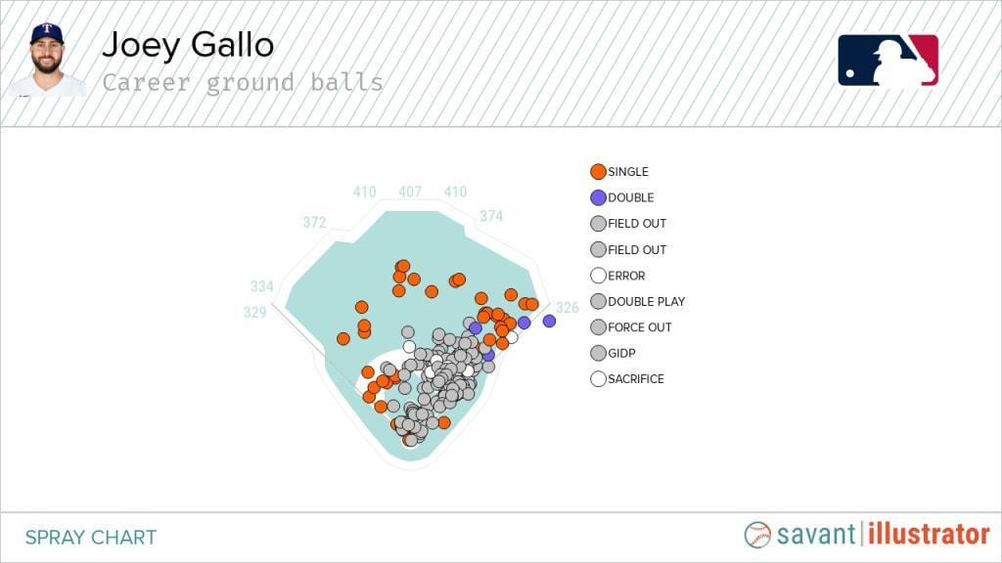
Background
What is the shift?
Why do teams use the shift?
Joey Gallo ground ball spray chart.
Notes:
As you can see in this spray chart, most of the time, when Joey Gallo hits a ground ball, he pulls it to the right side, so it makes sense for the opposing team to shift over. The shift is a large topic of discussion among baseball fans, managers, and analysts alike. Shifts have been happening at a much higher rate now than even 13 years ago. In 2011, there were shifts on 1.7% of plate appearances, while in 2021, there were shifts on 35.9% plate appearances.

Slide 4
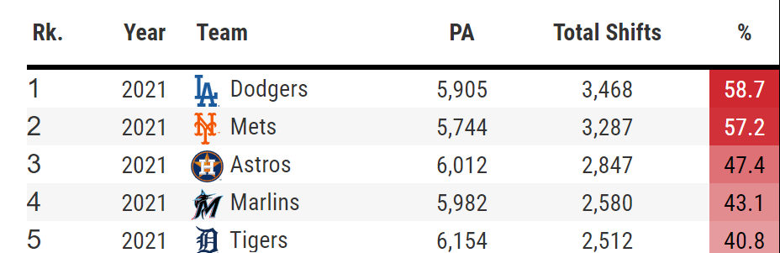
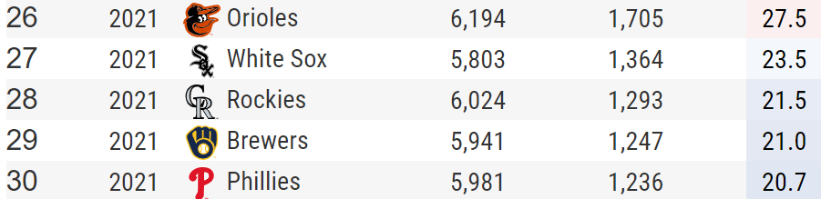
Background
What is the shift?
Why do teams use the shift?
Top 5 (above) and bottom 5 (below)teams in shift rate.
Notes:
Even within major league baseball, there is a high variance of the rate that teams shift against opposing batters. For example, the 2021 Los Angeles Dodgers shifted 58.7% of the time, while the Philadelphia Phillies in the same year shifted 20.7% of the time. (Now, you might say the Phillies are not comparable to the Dodgers – they’re not in the same division, they’re different quality teams – so it may be worth noting that the San Francisco Giants only shifted 34.7% of the time, which ranked 19th.

Slide 5
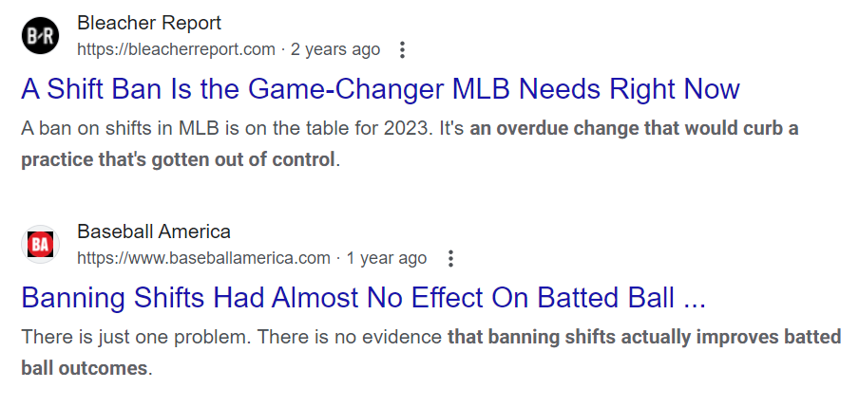
Background
AA restricted the shift in 2021, while MLB restricted the shift in 2023.
Feelings are mixed about the shift.
Notes:
AA restricted the shift in 2021, while MLB restricted the shift in 2023. An MiLB.com article stated, “These restrictions on defensive positioning are intended to increase the batting average on balls in play.” This statistic is commonly referred to as “BABIP”. An overarching theme of the MLB’s rule change initiatives is to make the game more exciting for fans, and that is usually interpreted as higher scoring games, more home runs, and less strikeouts, so if the rule change causes those trends as well, it is considered a success. At an economic level, this would increase fan engagement, leading to higher ticket sales, more lucrative television contracts, and increased revenues.

Slide 6
Existing Work
Doan, “Shifting Expectations: An In-Depth Overview of Players' Approaches to the Shift Based on Batted-Ball Events.”
Sawchik, Big Data Baseball: Math, Miracles, and the End of a 20 Year Losing Streak
Glaser, “Banning Shifts May Not Make Much Difference in MLB”
Notes:
As for existing work, Connelly Doan published an article in the Baseball Research Journal aimed at studying players’ approaches to the shift. The main goal was to determine how batters and pitchers were reacting to the shift, whereas this research’s goal is to determine whether a causal relationship exists between the shift and batter outcomes. This analysis is fundamentally different from mine, as Doan uses descriptive statistics to look at trends in batted ball data, while this project includes a strategy for determining causal effect.
Travis Sawchik wrote the book Big Data Baseball, which extensively describes the history of the shift, how it was implemented, anecdotal evidence of the shift ‘working’, and some statistical analysis to support his claims. For example, he tries to isolate the effectiveness of shifts by looking at year-to-year BABIP data at the major league level, noting that, “From 2006 to 2008, the major league batting average on balls in play hovered between .303 and .300, around the historical average. The number fell to .295 in 2011 and to .293 in 2013.” Sawchik also focuses on the story of the Pittsburgh Pirates, centralizing their playoff berth as the topic of the book and their data-driven adjustments as the reason for the playoff berth. This research focuses on baseball more broadly, approaching the shift from an interleague perspective, comparing AA to MLB.
The article that made me look into this topic was “Banning Shifts May Not Make Much Difference in MLB”. Kyle Glaser uses minor league BABIP data to compare season by season statistics at the AA level, concluding that there was not a significant effect on BABIP as a result of the ban of the shift. However, the problem with this result is that Glaser uses 2019 AA and 2018 AA as control groups, without any reasoning why 2021 AA in the control state of the world should be comparable to those years. The players that played in 2021 AA may have been fundamentally different than those in 2019 and 2018 – and a plausible explanation for why would be the COVID-19 pandemic that prevented players from competing in 2020, possibly affecting the quality of batters in 2021 AA.

Slide 7
Data
Baseball Reference (Team Level)
FanGraphs (Player Level)
Baseball Savant (Visuals, Ground Ball Stats)
Notes:
One of the key data sources used in baseball analytics is Baseball Reference. Baseball Reference has minor league and major league statistics for team level runs per game, batting averages, ops, etc., so it is possible to try to explore the causal relationship with the rule change and those outcome variables. On the player level, FanGraphs data for MLB is blocked by a subscription paywall. I use Baseball Savant for visuals, like the one with Joey Gallo earlier. They also have ground ball data for the MLB, but nothing for the minors.

Slide 8
Identification Strategy
2x2 Differences-in-differences
Fixed effects model
v_{y}: Year fixed effects
v_{l}: League fixed effects
v_{t}: Team fixed effects
Notes:
To setup the two by two difference-in-differences, we have Y_lt on the left, which is our outcome variable – BABIP, runs per game, batting average, home runs per game, etc. run in separate regressions. We need a dummy variable that equals 1 if a unit is ever treated – in this case, call it RESTRICT_l, which equals 1 if the league (l) is AA (where the defense is restricted) and 0 otherwise. This will control for differences between treatment and control units that don’t change over time. Then we need a dummy variable that equals 1 if the time period is after treatment – call it POST_t, which equals 1 if the year is 2021 or later and 0 otherwise. This will control for the things that change over time for all units regardless of treatment. We need an interaction term RESTRICT_l*POST_t, Where the coefficient delta will be the treatment effect. This interaction will pick up differences for treatment units that won’t be explained by the baseline differences from control units or by the change over time for control units. This term will equal 1 for AA observations in years 2021 and later. An extension to this model is a fixed effects model: where v_y represents year fixed effects to control for league-invariant temporal shocks such as COVID, v_l represents league fixed effects to control for time-invariant league characteristics such as average age of minor leaguers being younger, and v_t represents team fixed effects to control for time-invariant team characteristics, such as the ballpark they play at.

Slide 9
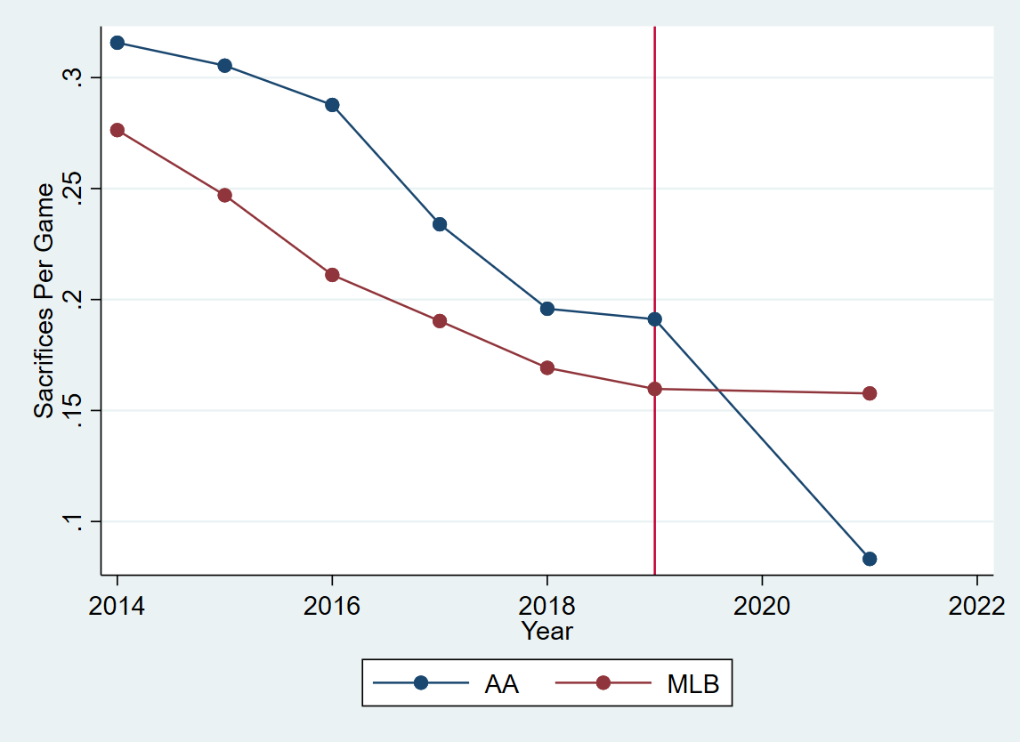
Parallel Trends
Notes:
Here is a graph showing roughly parallel trends for sacrifices per game. You’ll notice that there’s no data for 2020, as AA didn’t have a season, while MLB’s season was shortened to 60 games. (One could imagine that the time off from baseball during 2020 could have changed training habits for different players. Imagine AA players who were not making much money to begin with, and then they cannot work for a whole year due to the pandemic.) There were talks of getting rid of some minor league teams or cutting down the amount of player jobs available. This might weed out older players who don’t have much hope of making the MLB, but who could have performed well in AA had this policy not been put into place. This could lower batter outcomes in AA. If this doesn’t affect batter outcomes in the MLB in the same way, parallel trends is violated.

Slide 10
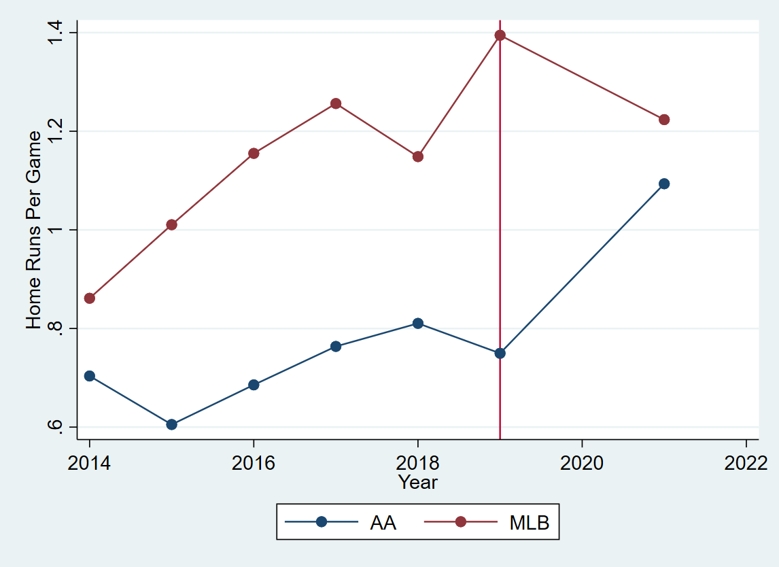
Parallel Trends

Slide 11
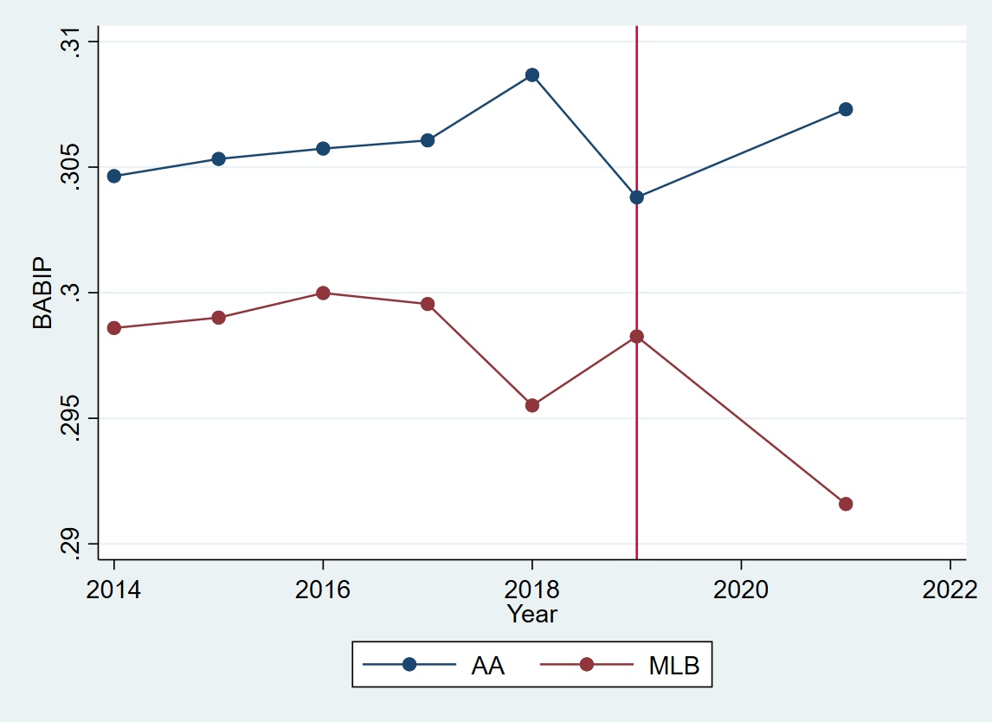
Parallel Trends

Slide 12
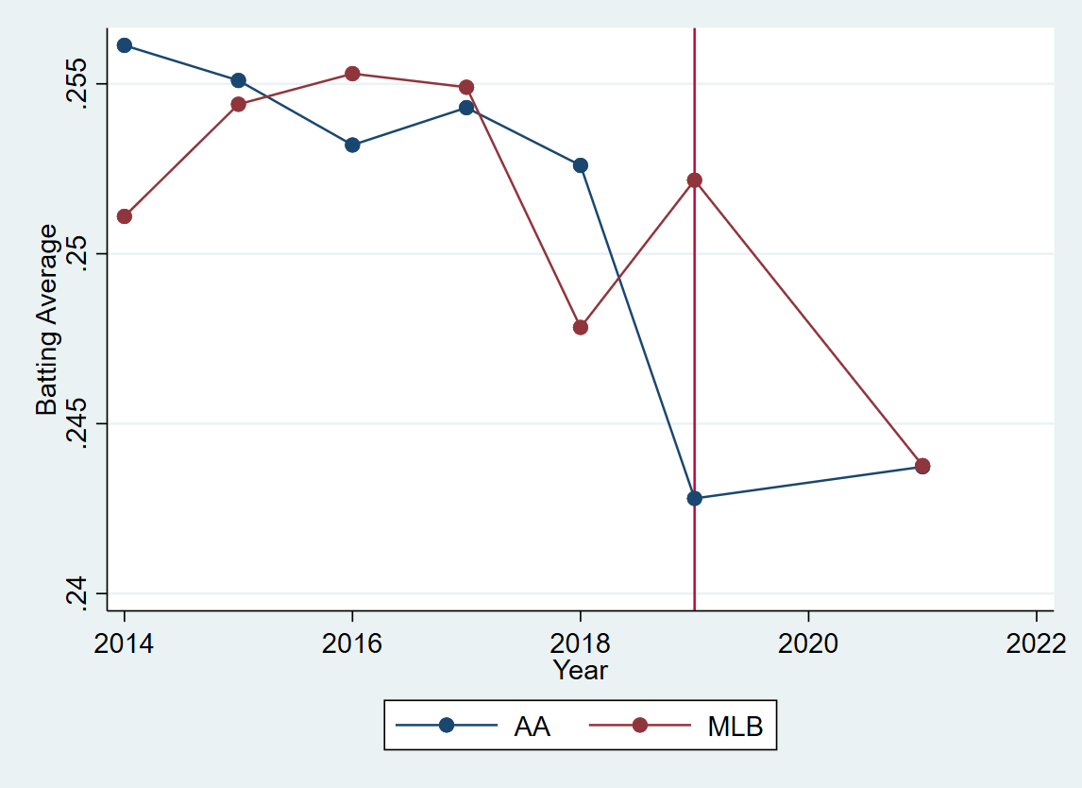
Parallel Trends

Slide 13
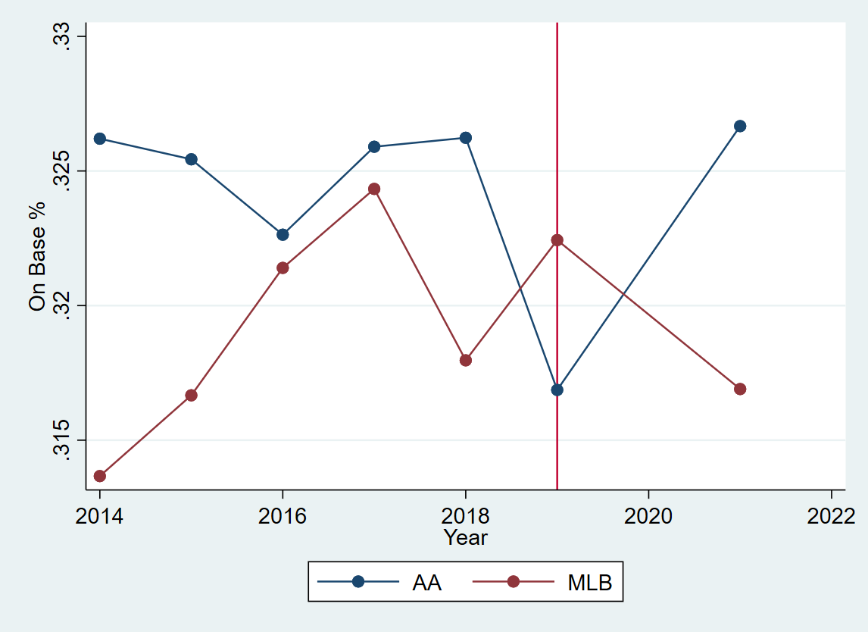
Parallel Trends

Slide 14
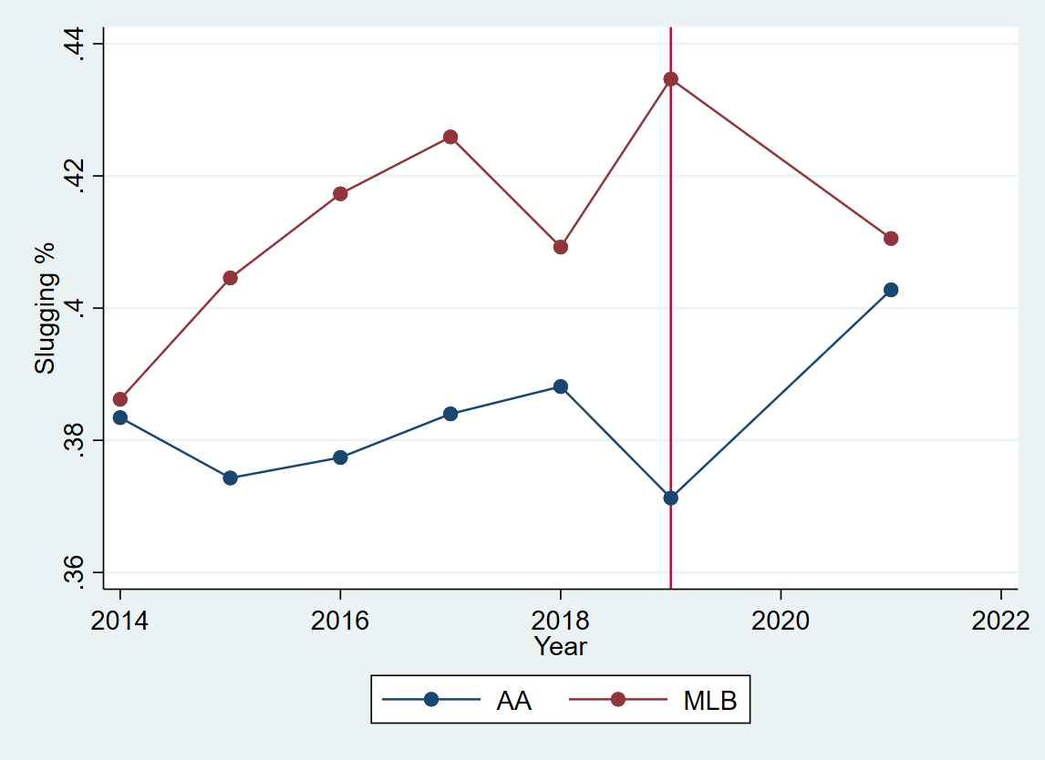
Parallel Trends

Slide 15
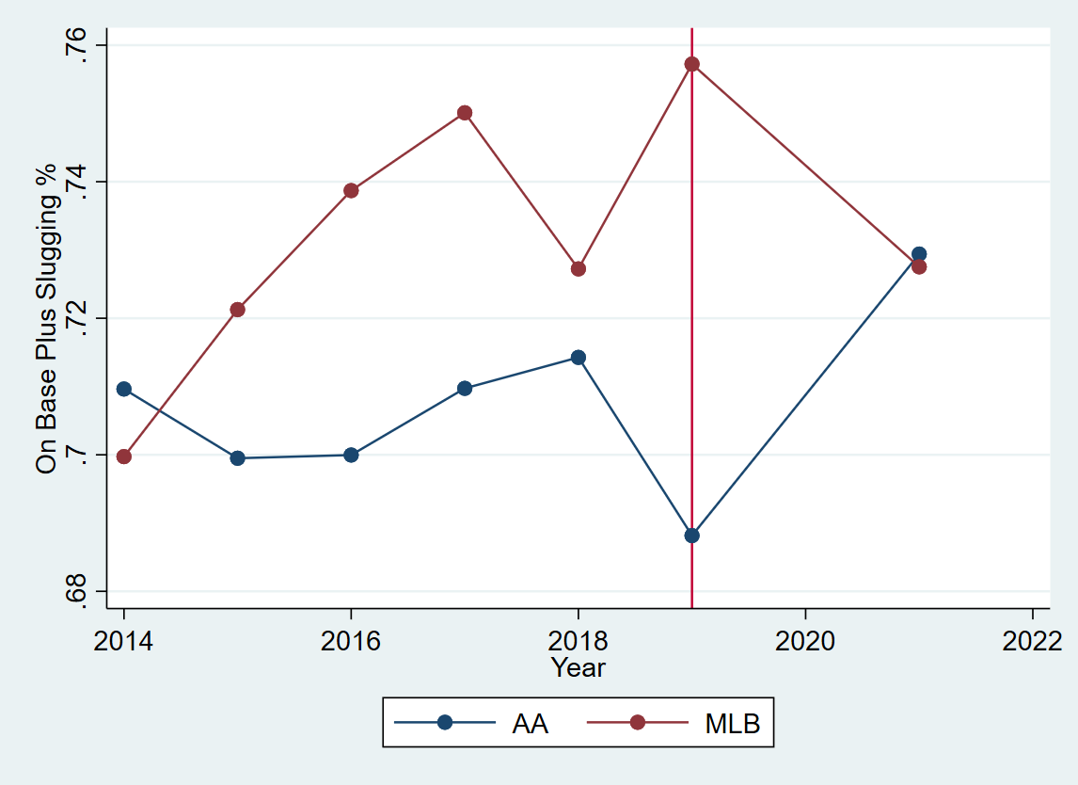
Parallel Trends

Slide 16
Spillovers
Does the treatment affect the control group?
Players do move from league to league
Notes:
Another assumption has to be satisfied – that there are no spillovers from the treatment into the control group. If the treatment affects the control group’s outcomes, then it is no longer a good counterfactual for the treatment group. In the context of baseball, one possible spillover is that players move from league to league. (Take a player that starts in AA and then goes up to the MLB. They may have made adjustments to their swing based on the shift ban, pulling more balls. It is fair to assume that developmental coaches do not want to change a player’s swing midseason, so they keep this approach in the MLB, but it is not as successful because teams are allowed to shift. Then, they do not represent a good counterfactual to a AA player without the shift ban because they changed their swing due to the shift ban when they wouldn’t have otherwise.) I still believe that this will be rare and won’t bias our findings.

Slide 17
Results
Notes:
So with that in mind, lets look at the results.

Slide 18
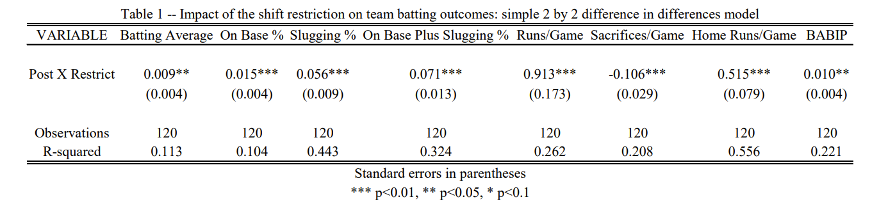
Results
2x2 Differences in Differences
Notes:
This table is zooming in on the main 2 by 2 differences in differences between 2019 and 2021 and AA and MLB. Every batting outcome is significant at a 5% level, and everything except batting average and BABIP is significant at a 1% level. As for the negative coefficient on sacrifices, it’s neither a positive nor a negative outcome, it represents a change in strategy. When the shift was allowed, batters might have been more likely to bunt, trying for a hit because of the open field, but inevitably some of those bunts ended up moving the runner over and being scored as a sacrifice.

Slide 19
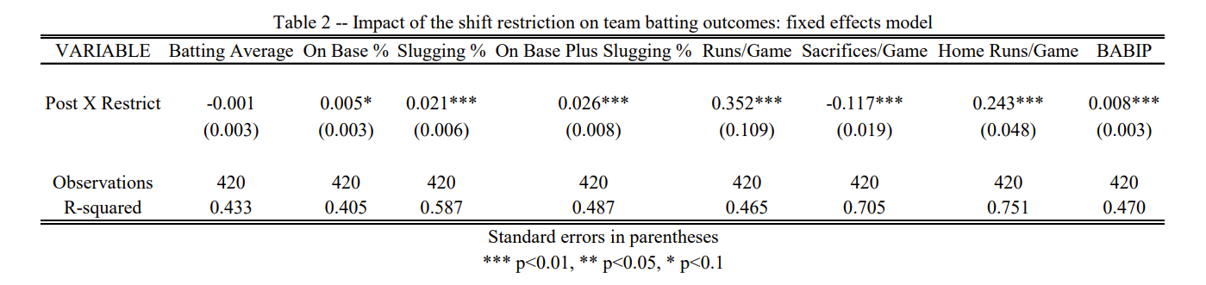
Results
Fixed Effects Model
Notes:
In this model, we’re running the second regression, where we have year, league, and team fixed effects for the whole time period 2014-2021. The coefficient on batting average is now insignificant, and on base percentage is marginally significant at the 10% level. BABIP, the motivating factor in this research, increased, contrary to what year to year trends at the AA level suggested.
We see that in both models, home runs per game increased. This is a bit surprising, as the main focus was on increasing Batting Average on Balls In Play, and a home run isn’t counted as a ball in play. We could tell a story about why this might happen: maybe pull hitters are affected by the shift restriction more, where previously, they might have been trying to hit the ball to the open field to react against the shift, hitting less home runs as a result, but now, they play to their strengths, pulling the ball and hitting with more power more frequently, resulting in more home runs.

Slide 20
Future Work
Player Level Data
Ground Ball Specific Data
Other Leagues as Controls
More Post Treatment Observations
Notes:
As for future work, with player level data, the results might be more convincing by looking at individual changes in batting outcomes. Also, with specific data on players, we can more accurately paint a picture of why home runs are increasing.
With ground ball specific data, we can look at specifics about how batters’ approach changes, such as if they’re pulling the ball more due to the shift restrictions.
If we use other leagues as controls, such as single A or triple A, we can investigate some of the batting outcomes where parallel trends didn’t hold for the MLB, such as runs per game and OPS.
Lastly, if we analyze more post treatment observations, we’ll get a better understanding of how the shift restriction’s effects play out long term, whether or not there’s continuous improvement by batters as they continue to adjust, or whether or not there’s a strategic counter by pitching and defense looking for an alternative option to extreme shifts.

Slide 21
THANKS!
Any questions?
Notes:
Thank you for listening, and I’ll open it up to questions!

